Slide 1
NRK CODERS
SUBMITTED BY:
NAVNEET KAUR
RAJESH KUMAR
KHUSHBOO

Slide 2
OVERVIEW
Effective navigation to parking spots based on availability and distance, taking into account.
Offers customers the possibility to reserve and pay for their parking spots.
Screen has been launched with particular logo.
They can choose payment options.
.Customers can use registration and login option to use application further.

Slide 3
DIFFICULTIES FACED
Time management.
Defining requirements and functionalities.
.Removing errors(Thread).
Coding in view controller.

Slide 4
WHAT NEW LEARNT?
How to create an Ios application.
How to make and run applications.
Creation of launching screen with particular time limitation.
.Using image LOGO, register, login using tool bar with outlet and action functions.

Slide 5
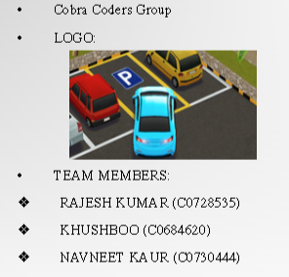
GROUP DETAILS

Slide 6
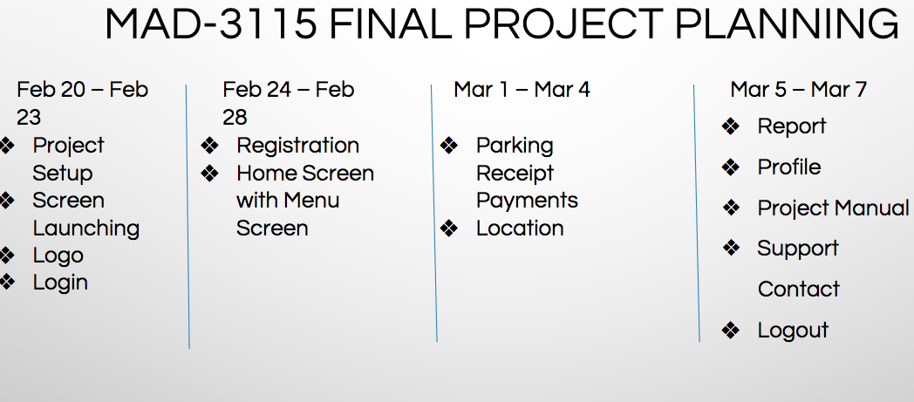
SPRINTS DESIGNS

Slide 7

MAIN SCREEN
This is launcher screen of
our application which demonstrates
the beginning of the application.

Slide 8
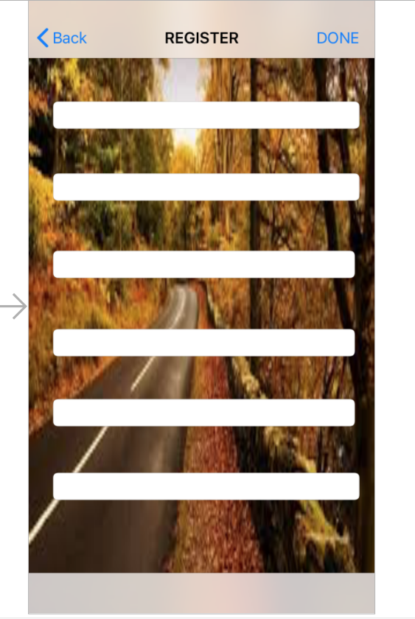
REGISTER PAGE
This page is to be used by new user for
registering to this application

Slide 9
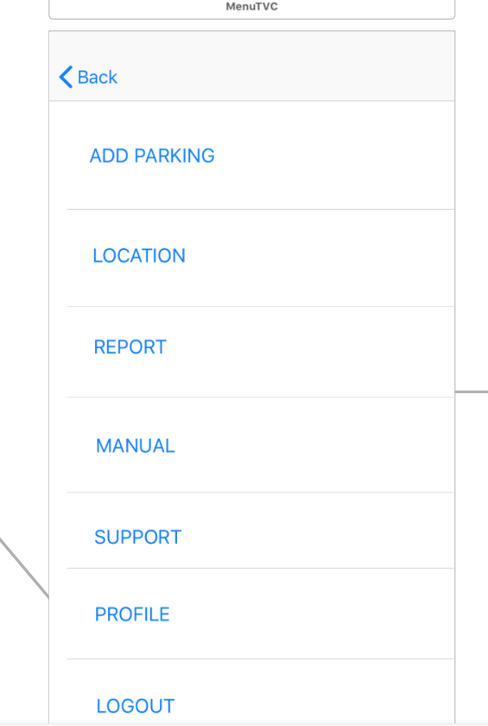
MENU
This page shows all the menu options
from which user can select
the desired option.

Slide 10
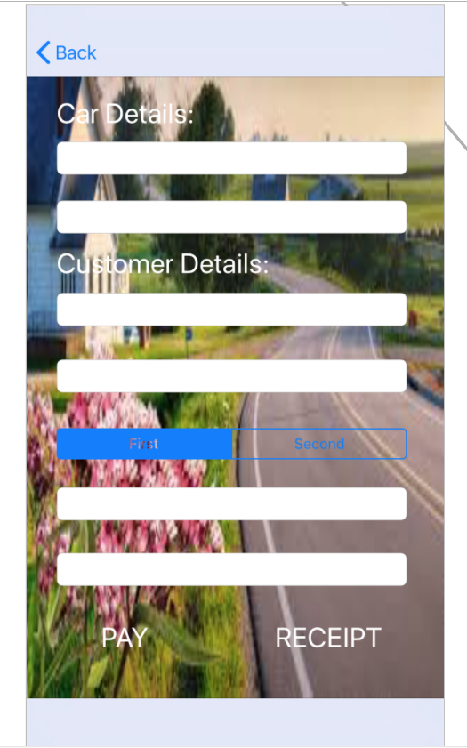
PARKING AND VEHICLE INFORMATION
This page includes all the details
of vehicle and parking information.

Slide 11
ADD PARKING
This page includes customer details
and car details which is further
used for making payments
and receiving receipts. customer gets
multiple payment options.

Slide 12
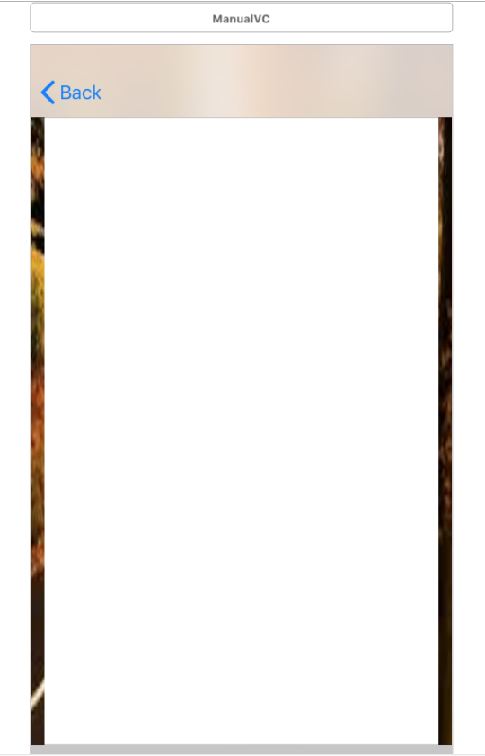
MANUAL
This page is used by administrator for
displaying all the information about parking
system for his personal view.

Slide 13
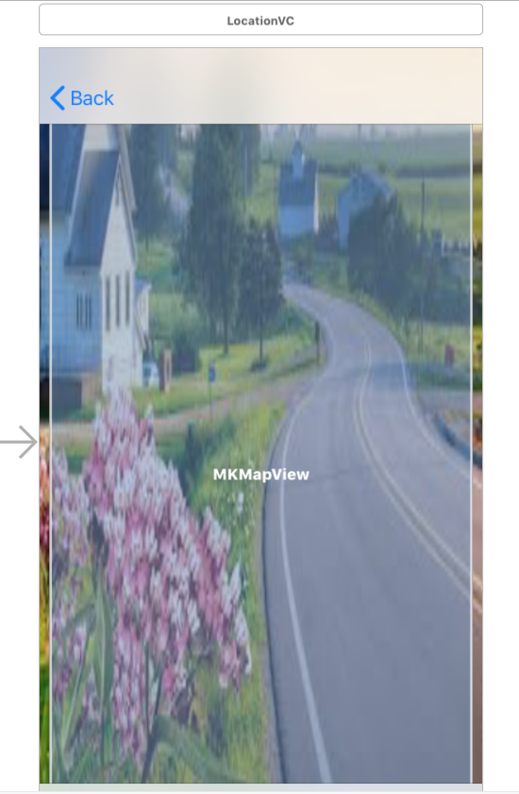
LOCATION
This page shows user the location where his
vehicle is parked so that it can be
easily found.
This information is also useful for
administrator.

Slide 14
THANK YOU QUERIES & SUGGESTIONS?....

